Slide 1
SMART TASK DETECTION SYSTEM
Submitted in the partial fulfillment for the award of the degree of
BACHELOR OF ENGINEERING
IN
NAME_OF_SPECIALIZED_BRANCH
Submitted by:
Surya Srinija-22bai71022
Diksha Kumari – 22bai70141
Hemant Singh -22bai70252
Bappy -22bai70164
Under the Supervision of:
Ms.Priyanka Nanda(E16695) Mam
Department of AIT-CSE
DISCOVER . LEARN . EMPOWER

Slide 2
Outline
Introduction to Project
Problem Formulation
Objectives of the work
Methodology used
Results and Outputs
Conclusion
Future Scope

Slide 3
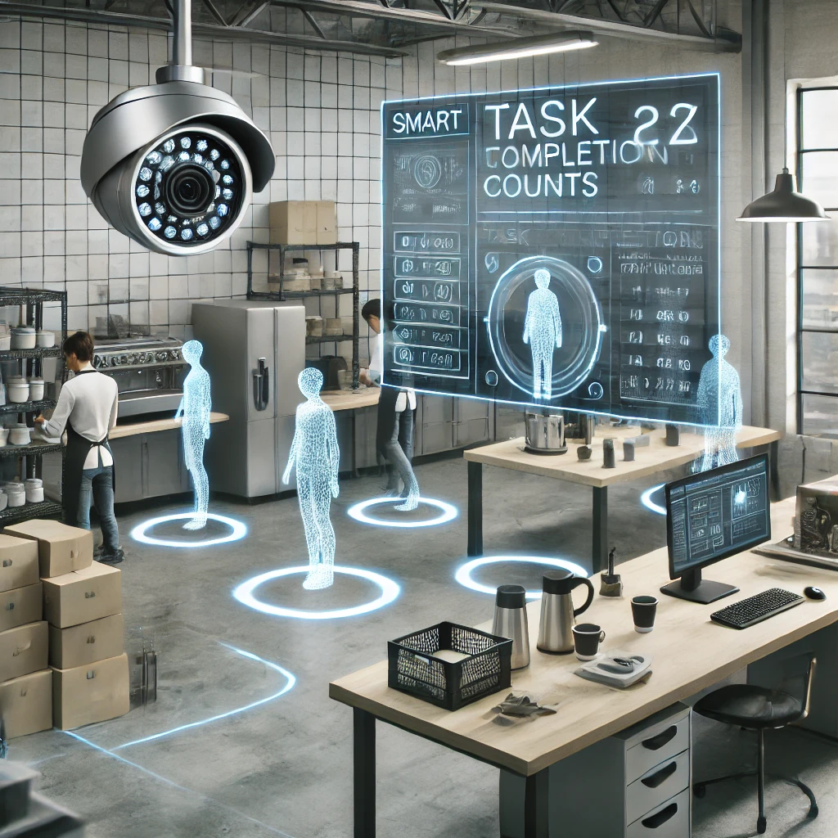
Introduction to Project
The primary goal of this project is to implement a system that leverages object detection technology to track and count specific tasks completed by employees in workplaces such as coffee shops, manufacturing units, or other industries where repetitive tasks are performed.
The system aims to replace traditional manual supervision methods with an automated, unbiased, and accurate task detection solution, improving productivity, fairness, and efficiency in task tracking and employee performance evaluation.
The project utilizes advanced computer vision techniques and deep learning frameworks, such as YOLO (You Only Look Once) or TensorFlow Object Detection API, integrated with CCTV footage for real-time task monitoring and detection.
The system identifies and tracks specific tasks, such as making coffee, packaging products, or assembling parts, by analyzing video footage. It then counts the number of times each task is performed and generates detailed reports.

Slide 4
Problem Formulation
Monitoring employee productivity manually is labor-intensive, prone to bias, and lacks real-time accuracy.
Supervisors may overlook tasks or inaccurately evaluate workload distribution.
Traditional systems struggle to track repetitive tasks like making coffee or assembling parts in real-time.
The absence of task-specific data leads to inefficiency in analyzing employee performance.
Handling multiple employees and tasks simultaneously becomes unmanageable without automation.
This can lead to disputes, dissatisfaction, and reduced trust between employers and employees.
Increasing demand for AI-based solutions to enhance workplace efficiency and reduce operational costs.
Reliance on human observation or manual logging introduces errors in task completion records.
Generating reports on employee productivity manually is a slow process.It delays decision-making and prevents real-time optimization of operations.
Existing monitoring solutions may lack real-time object detection, scalability, or customization for different tasks.
This creates a gap for an AI-powered system that provides precise, unbiased, and scalable task tracking.

Slide 5
Objectives of the Work
Automate Task Monitoring : Develop a system capable of real-time tracking of specific tasks performed by employees using CCTV footage. Replace manual supervision with AI-powered automation to ensure consistency and accuracy in task monitoring.
Ensure Accurate Task Counting:Implement advanced object detection algorithms to precisely count how many times a task, such as making coffee or assembling a product, is completed by each employee. Reduce errors and inaccuracies in task tracking caused by human observation.
Improve Productivity Measurement:Provide organizations with a reliable method to measure employee productivity based on task completion rates. Offer actionable insights to improve operational efficiency and identify top-performing employees.
Reduce Operational Costs: Minimize the need for manual supervision, thereby reducing the cost of hiring supervisors for task monitoring. Automate reporting and data analysis to save time and resources.
Enhance Workplace Efficiency:Reduce the time spent on manual task monitoring and reporting, allowing businesses to focus on core operations. Streamline workflows by identifying bottlenecks and optimizing task assignments.

Slide 6
Methodology
Data Collection: Collect video footage from CCTV cameras covering the workspace. Prepare a diverse dataset containing videos or images of employees performing the identified tasks.
Data Preprocessing: Perform preprocessing tasks like:
Resizing: Adjust image dimensions for compatibility with the detection model.
Normalization: Scale pixel values for consistent input.
Data Augmentation: Enhance the dataset with variations to improve model robustness.
Train the selected model on the preprocessed dataset using a framework like TensorFlow, PyTorch, or OpenCV.
Validate and fine-tune the model to optimize performance metrics (accuracy, precision, recall).
Implement multi-object tracking (e.g., SORT or DeepSORT) to track employees and their activities.
Count the number of times each task is performed by linking detections to specific time intervals.
Ensure compatibility with existing CCTV systems and cloud infrastructure for data storage and processing.
Develop a dashboard to display real-time task completion counts and employee productivity metrics.
Deploy the system on cloud platforms or edge devices, depending on workplace requirements.
Implement APIs or interfaces for easy integration with existing management systems.

Slide 7
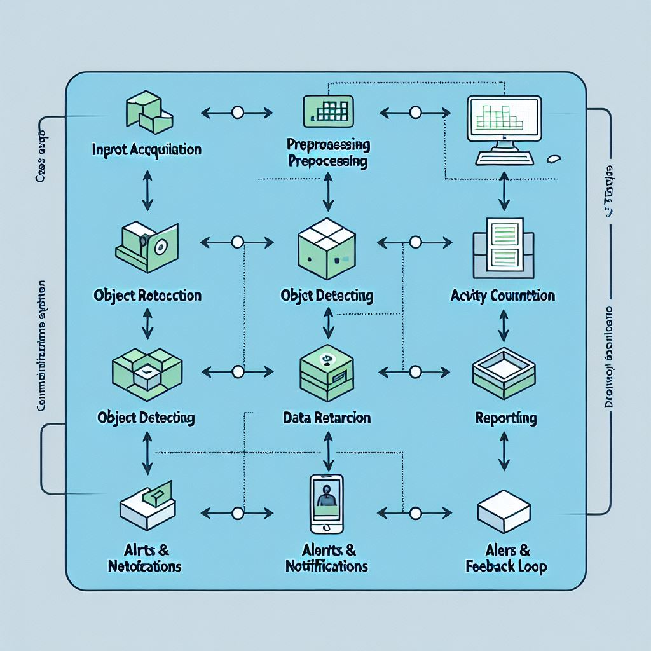
Working Flow

Slide 8
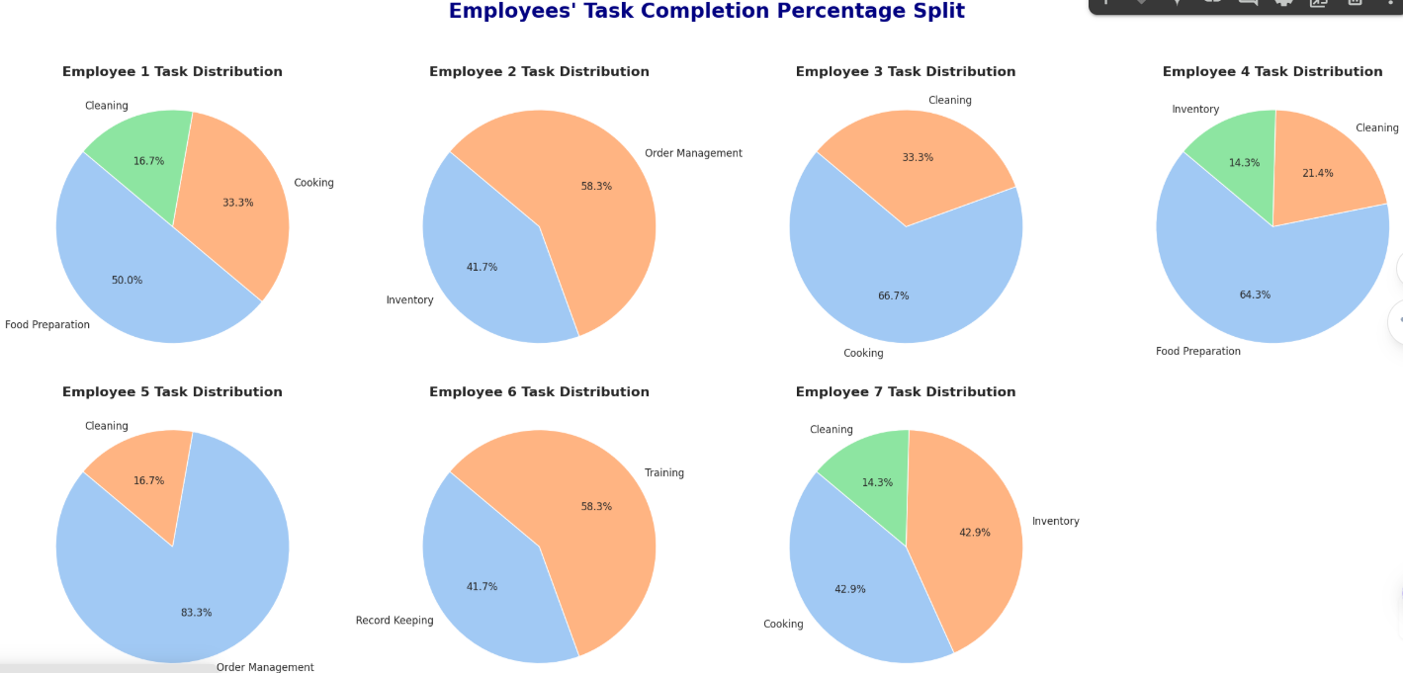
Results and Outputs
Employee Task Completion Percentage

Slide 9
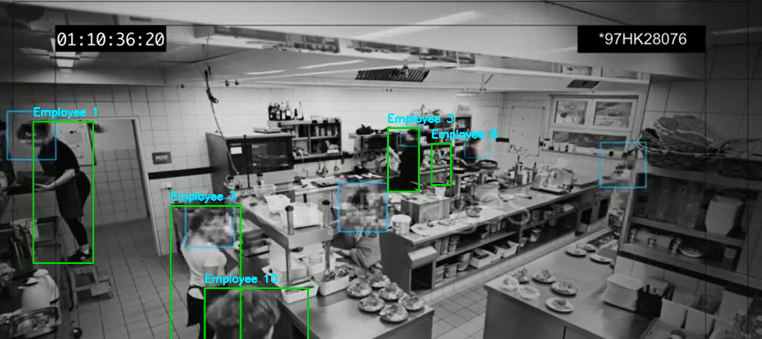
Results and Outputs
Employee Detection

Slide 10
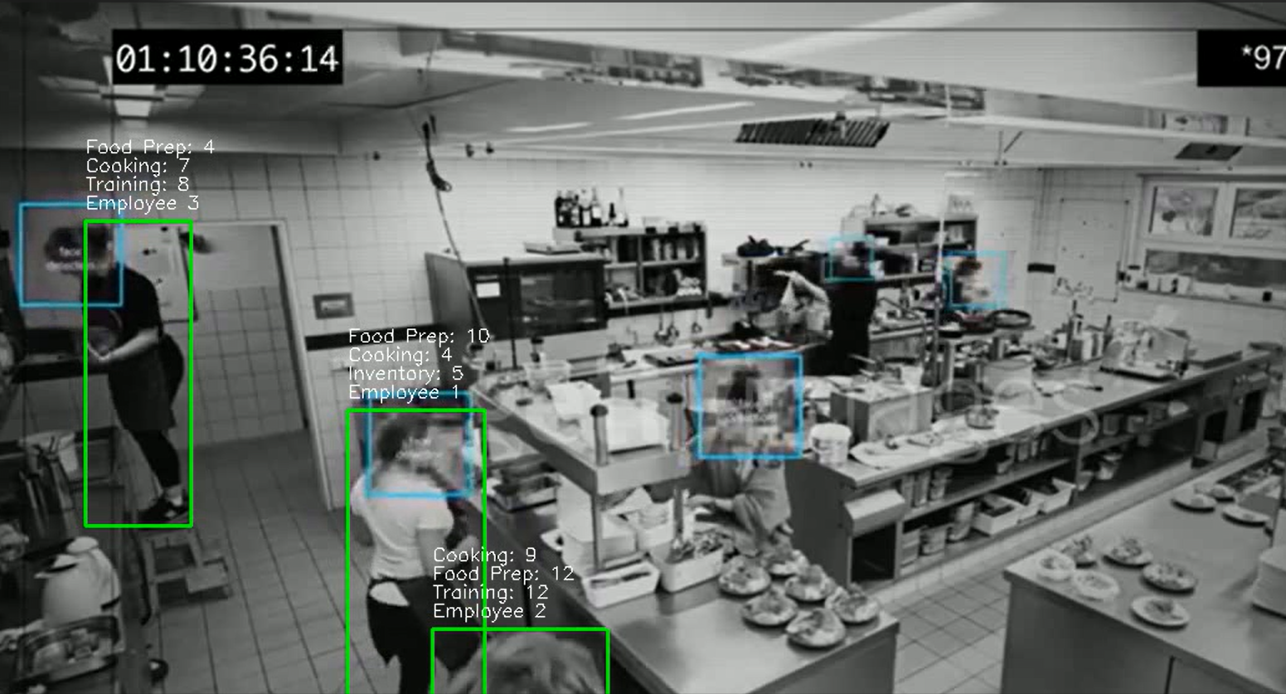
Results and Outputs
Task completion and counting

Slide 11
Conclusion
AI-Powered Efficiency: The Smart Task Detection System uses advanced AI and object detection to automate task monitoring, improving workplace efficiency.
Industry Adaptability: It can be customized for various industries, such as coffee shops, manufacturing, and packaging, to track specific tasks like making coffee or assembling parts.
Real-Time Monitoring: The system leverages CCTV footage to provide real-time insights into employee productivity and task completion.
Error-Free Automation: By eliminating manual supervision, it reduces human error and ensures unbiased tracking of tasks.
Data-Driven Improvements: The system offers valuable data to enhance workflow optimization, identify bottlenecks, and drive continuous improvement.
Scalable Solution: It can be easily scaled to fit both small and large-scale operations, offering flexibility for businesses of all sizes.

Slide 12
Future Scope
Integration with IoT Devices: Expanding the system to work with other IoT devices (e.g., smart sensors, wearable tech) to gather more detailed insights into employee movements and performance.
Advanced AI Training: Enhancing the AI model with more advanced machine learning techniques for better accuracy in task recognition and handling complex scenarios.
Predictive Analytics: Adding predictive features to forecast productivity trends, resource requirements, or potential downtime based on historical data.
Employee Feedback Integration: Incorporating employee feedback to create a more holistic understanding of task performance and satisfaction.
Cross-Platform Accessibility: Developing mobile and web applications for easier access to task data and real-time updates from anywhere.
AI-Driven Task Optimization: Leveraging AI to suggest optimized workflows or task assignments based on employee performance data.
Integration with HR Systems: Linking with HR software to track performance metrics, align with incentive programs, and provide valuable feedback for employee growth.

